Slide 1

PROJECT 2
-AIRLINE DATASET ANALYSIS USING SPARK
TEAM 404!
SUBMITTED TO :
GAJENDRA KUMAR SAMAL
OM PRAKASH SINGH
SAMANTA GUPTA
SRUTHY SEBASTIAN
AJAY SINGALA

Slide 2
OBJECTIVE
Spark Project - Airline Analysis
To create Spark jobs in Python (using PySpark) to perform various analysis on a Airline dataset stored in HDFS in csv format.
We took the data from the KAGGLE
We did 21 queries to analyze our dataset which include three csv flies which are:
AIRLINES.CSV
FLIGHTS.CSV
AIRPORTS.CSV

Slide 3
TECHNOLOGIES
Using Spark in Python
-The first step in using Spark is connecting to a cluster.
Using Spark DataFrames
-Spark’s DataFrame is a distributed collection of data, which is organized
into named columns
Using SparkSQL
-Every SQL query is made up of commands that tell the database what
you want to do with the data.
-Another common database task we used is aggregation.

Slide 4
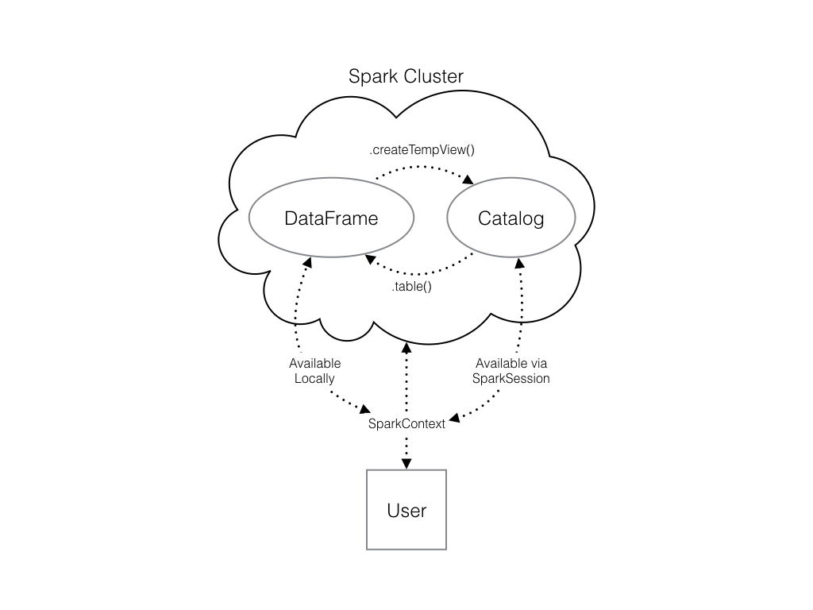
ARCHITECTURE DIAGRAM
SQL

Slide 5
GETTING STARTED
To Transfer File from Local machine to Sandbox:
scp -P 2222 ./airlines.csv maria_dev@sandbox-hdp.hortonworks.com:/home/maria_dev/Project_2
scp -P 2222 ./airports.csv maria_dev@sandbox-hdp.hortonworks.com:/home/maria_dev/Project_2
scp -P 2222 ./flights.csv maria_dev@sandbox-hdp.hortonworks.com:/home/maria_dev/Project_2
To move file on hdfs:
hdfs dfs -copyFromLocal ./flights.csv /user/maria_dev/Project_2
hdfs dfs - copyFromLocal ./airlines.csv /user/maria_dev/Project_2
hdfs dfs -copyFromLocal ./airports.csv /user/maria_dev/Project_2

Slide 6
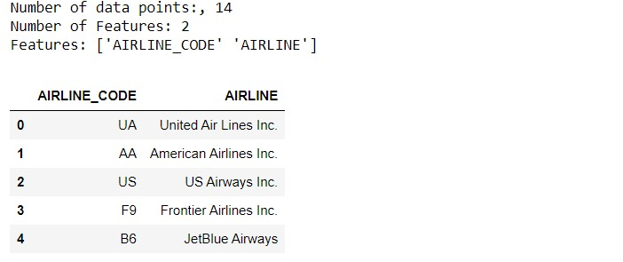
AIRLINES.CSV

Slide 7
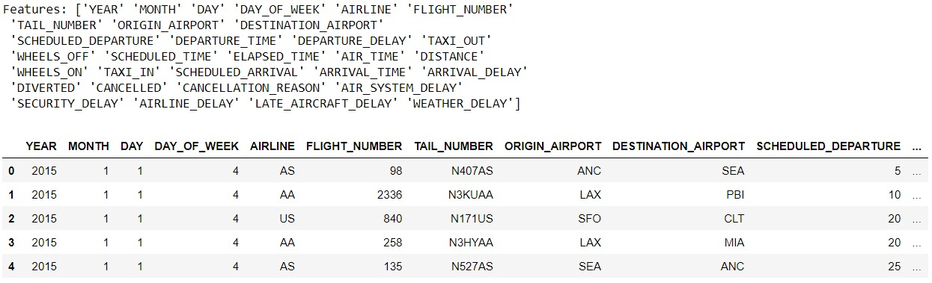
FLIGHTS.CSV
Number of data points - 400010
Number of features - 31

Slide 8
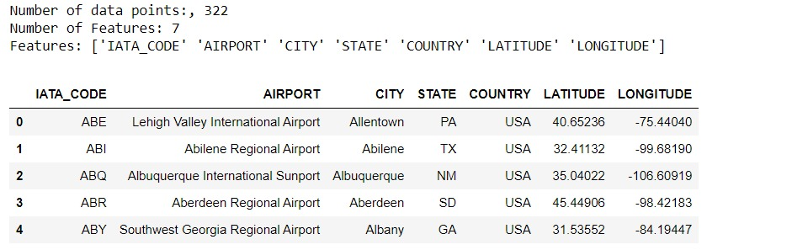
AIRPORTS.CSV

Slide 9
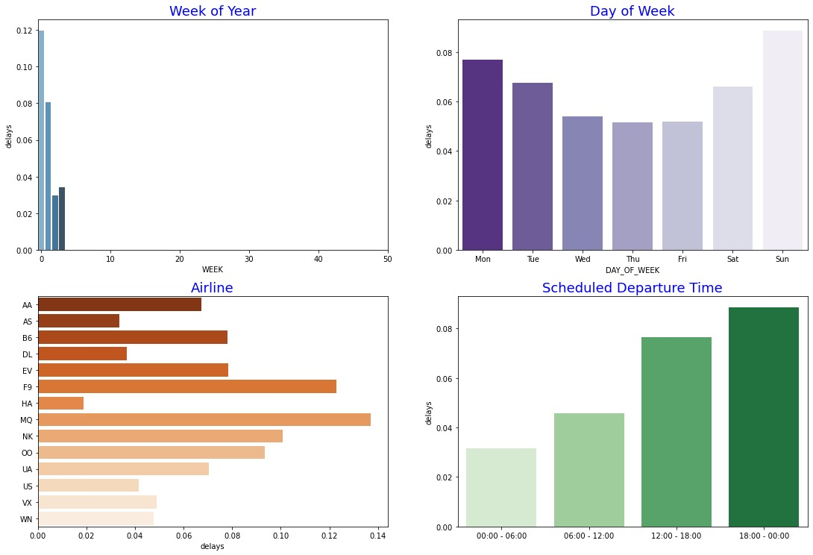
DATASET ANALYSIS

